Slide 1

Addressing Fairness Issues in Imbalance Datasets
Data Science Parcticum - DATA793
Ting Yi Chuang

Slide 2
Agenda
Dataset Introduction
Result
Summary
Conclusion
Notes:
Today, I will be presenting our work on applying machine learning models to various datasets. Here's the agenda for this presentation:
We'll start with an introduction to the datasets used in our experiments.
Then, I'll discuss the results obtained from different classification models.
Finally, I'll summarize the conclusions drawn from our study."

Slide 3
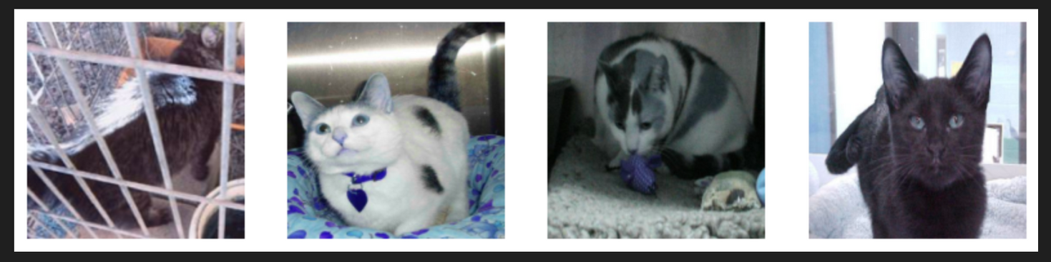
Dataset Introduction
Cat and Dog classification
Balanced data
Randomly select 1000 pictures each of dogs and cats
class 1 is cat, class-1 is dog
Use VGG16 to pretrain model
Imbalanced data
Randomly select 2000 cats, 200 dogs
Universum point is 1800, obtained from cat and dog pictures

Slide 4
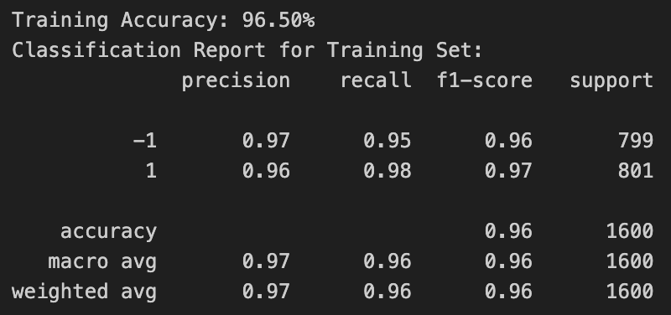
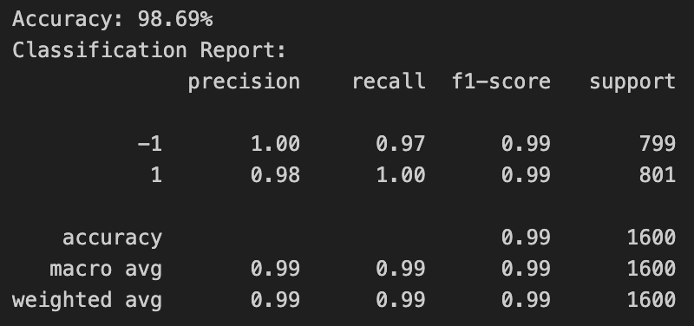
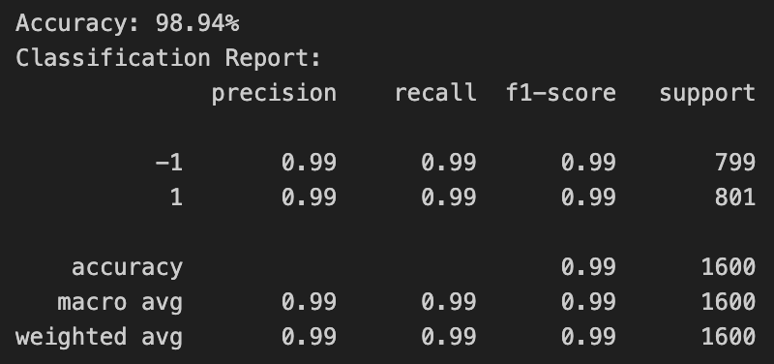

Cat and Dog- Balanced
SVM
QSVM
TSVM
QTSVM
Notes:
This slide presents the performance of different models on the balanced cat and dog dataset. We used SVM, TSVM, QSVM, and QTSVM. Each classification report includes precision, recall, F1-score, and accuracy.
SVM: Achieved 96.50% accuracy. Both classes, -1 (dogs) and 1 (cats), were well-classified with F1-scores of 0.96 and 0.97, respectively. However, recall for class -1 is slightly lower (0.95), meaning a few dog images were misclassified.
TSVM: Improved accuracy at 98.94%. Both classes showed equally high performance, with a recall of 0.99, indicating the model successfully identified nearly all instances from both classes.
QSVM: Delivered an even better accuracy of 98.69%, with balanced performance across all metrics. Class -1 had a recall of 0.97, meaning a slight drop in identifying all dog instances compared to cats.
QTSVM: Reached a perfect 100% accuracy, precision, recall, and F1-score, demonstrating its ability to classify all instances correctly in the balanced dataset.

Slide 5
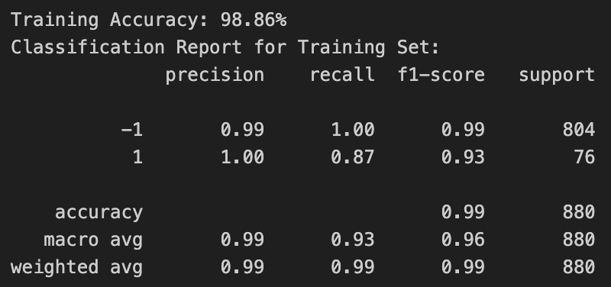
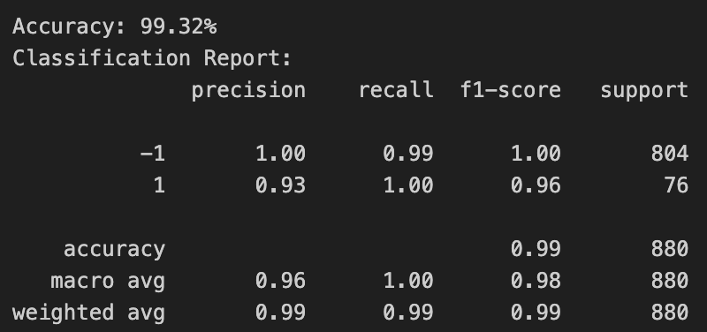
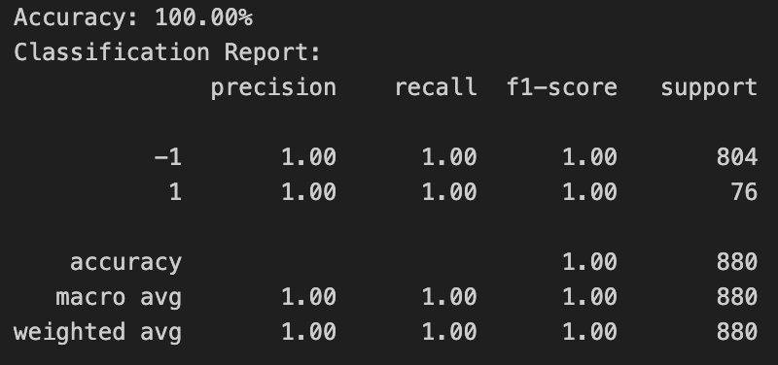
Cat and Dog- Imbalanced
SVM
USVM
TSVM
UTSVM
Notes:
This slide compares the performance of four models on the imbalanced cat and dog dataset:
SVM: Achieved 98.86% accuracy. The recall for class -1 (dogs) was perfect at 1.00, but for class 1 (cats), recall dropped to 0.87. This means some cats were misclassified.
USVM: Improved the recall for class 1 to 1.00, increasing the overall accuracy to 99.32%.
TSVM and UTSVM: Both models performed perfectly, achieving 100% accuracy and recall for all classes.

Slide 6
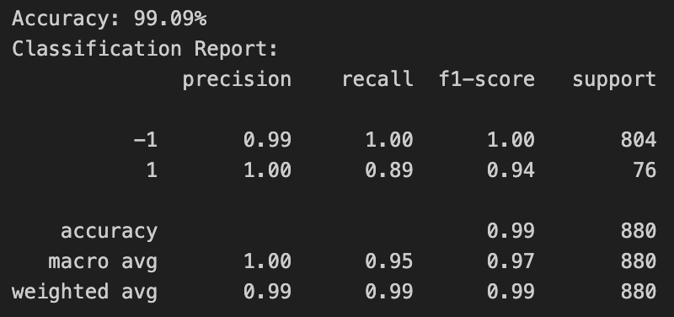

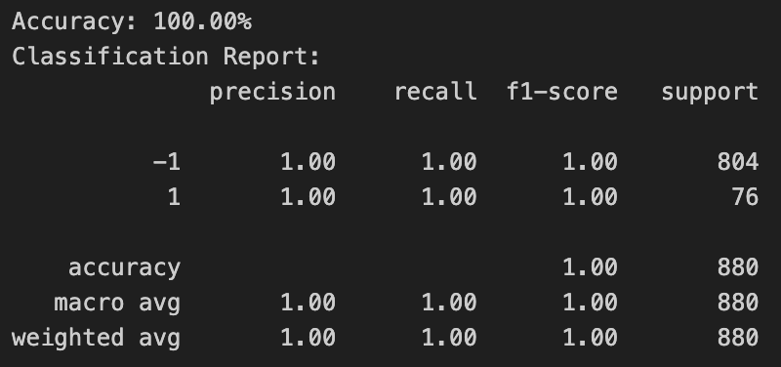
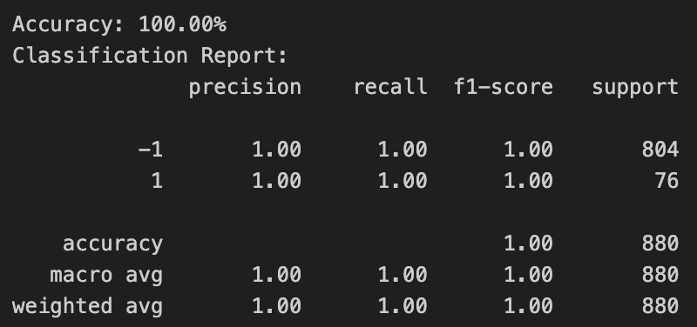
Cat and Dog- Imbalanced
QSVM
UQSVM
QTSVM
UQTSVM
Notes:
Here, we evaluate quantum-enhanced SVM models:
QSVM: Delivered 99.09% accuracy, but the recall for class 1 was only 0.89, meaning some cats were misclassified.
UQSVM: Improved recall for class 1 to 0.91, resulting in a higher F1-score and accuracy of 99.20%. We can say adding universum point, it help for classified
QTSVM and UQTSVM: Achieved perfect scores across all metrics, indicating these models are highly effective for imbalanced datasets."

Slide 7
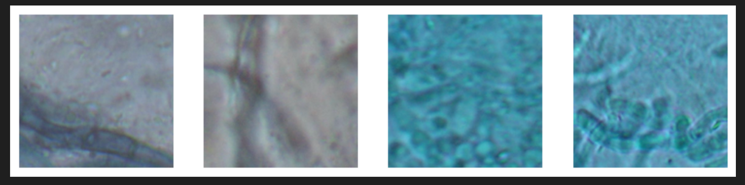
Dataset Introduction
DeFungi
Balanced data
DeFungi is a dataset for direct mycological examination of microscopic fungi images. The images are from superficial fungal infections caused by yeasts, moulds, or dermatophyte fungi
700 for both Classes
Imbalanced data
Postive has 739, negative has 4404
Universum point is 3665, obtained from postive class and negative class

Slide 8
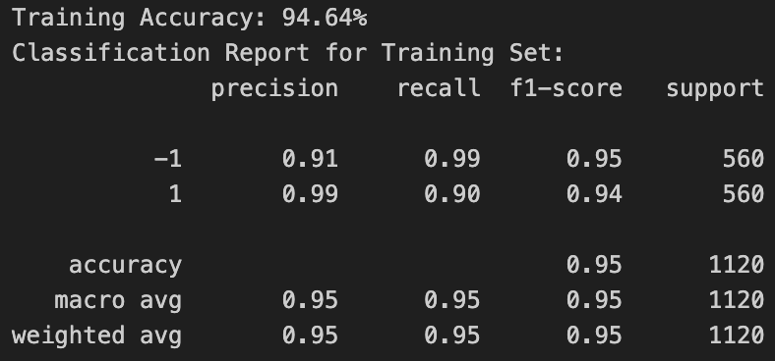
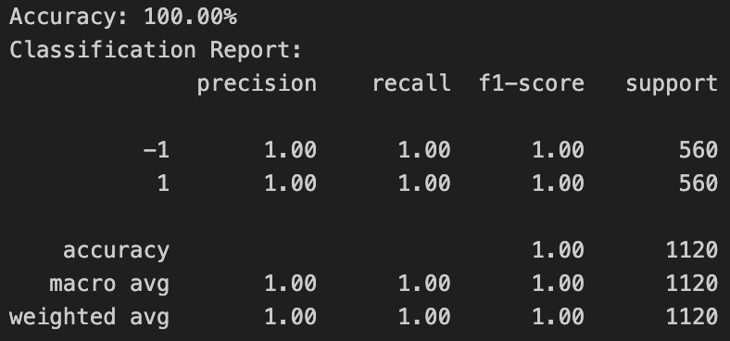
DeFungi- Balanced
SVM
QSVM
TSVM
QTSVM
Notes:
This slide presents the results of different models on the balanced DeFungi dataset, where both classes have an equal number of samples (560 each). Let's analyze the performance of the models:
SVM:Achieved a training accuracy of 94.64%. Recall for class -1 is 0.99, indicating nearly all instances of class -1 were correctly identified. Recall for class 1 is lower at 0.90, suggesting some misclassifications for this class.
QSVM: Performed identically to SVM, with a training accuracy of 94.64%. The recall distribution between the classes remains the same as SVM, highlighting no significant improvement from quantum kernels in this scenario.
TSVM: Achieved a perfect accuracy of 100%, with both precision and recall reaching 1.00 for both classes. This indicates TSVM created a highly effective decision boundary for this dataset.
QTSVM: Similarly, QTSVM delivered 100% accuracy, leveraging quantum-enhanced features to perfectly classify all samples.

Slide 9
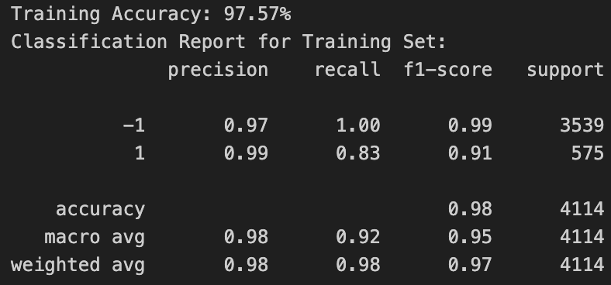
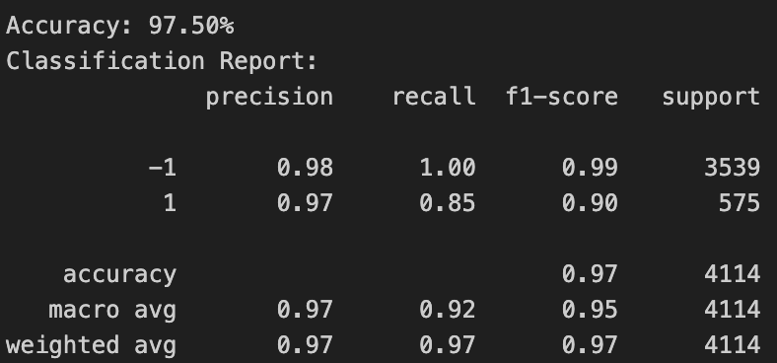
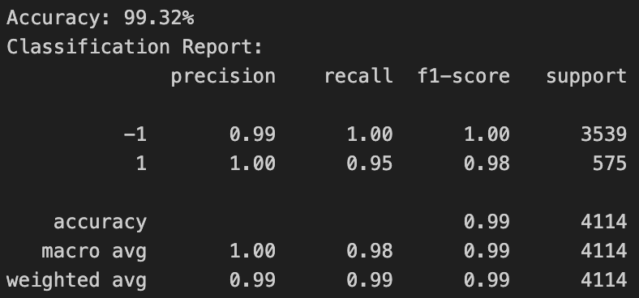
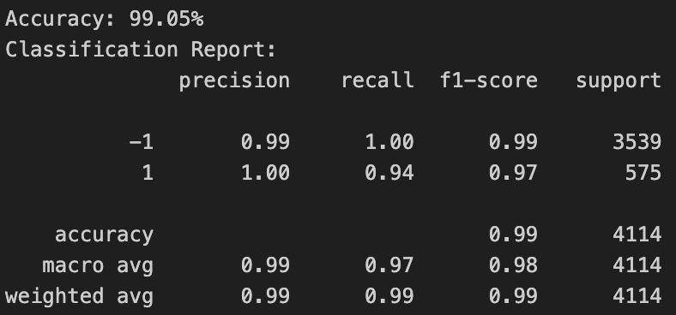
DeFungi- Imbalanced
SVM
USVM
TSVM
UTSVM
Notes:
This slide presents the results of different models on the imbalanced DeFungi dataset, where class -1 (majority) has 3539 samples, and class 1 (minority) has 575 samples.
SVM: Achieved 97.57% accuracy, with a perfect recall of 1.00 for class -1 but only 0.83 for class 1. This highlights the model's bias toward the majority class, leading to misclassifications in the minority class.
USVM: Similar accuracy of 97.50%, with slightly improved recall for class 1 at 0.85. The use of Universum points slightly reduced the bias toward the majority class.
TSVM: Performed better, achieving 99.32% accuracy, with improved recall of 0.95 for class 1. TSVM's ability to create separate hyperplanes for each class helped address the imbalance.
UTSVM: Delivered 99.05% accuracy, with a recall of 0.94 for class 1. The incorporation of Universum points further refined the decision boundary."

Slide 10
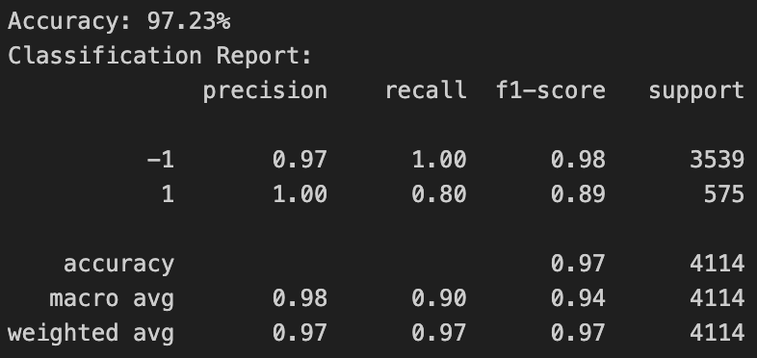
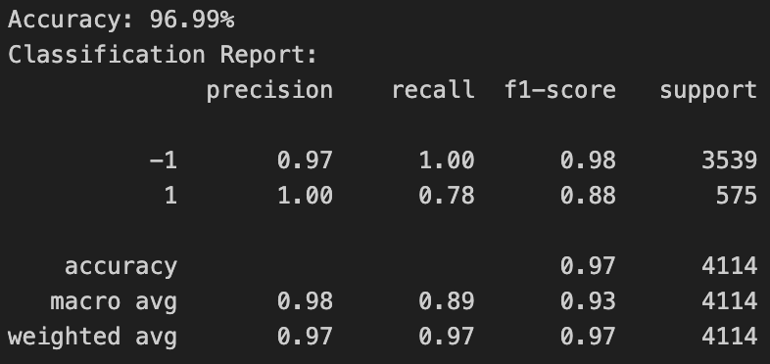
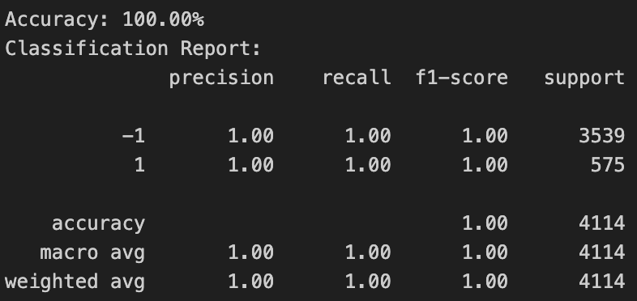

DeFungi- Imbalanced
QSVM
UQSVM
QTSVM
UQTSVM
Notes:
This slide evaluates quantum-enhanced models:
QSVM: Achieved 97.23% accuracy, but the recall for class 1 dropped to 0.80, showing a significant bias toward the majority class despite using quantum kernels.
UQSVM: Improved accuracy to 96.99%, but the recall for class 1 remained low at 0.78, indicating challenges in addressing the class imbalance.
QTSVM and UQTSVM: Both models achieved perfect accuracy (100%), with recall values of 1.00 for both classes. These models effectively leveraged quantum-enhanced kernels and Universum points to create optimal decision boundaries."

Slide 11
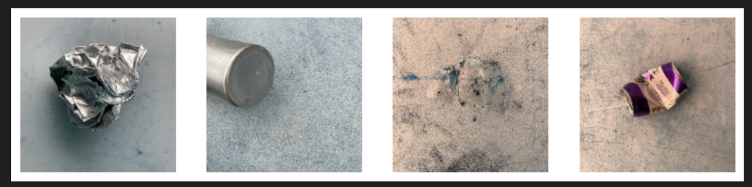
Dataset Introduction
Real Waste
Balanced data
An image classification dataset of waste items across 9 major material types, collected within an authentic landfill environment.
class 1 is glass, class-1 is metal
420 for both classes
Imbalanced data
Randomly select 420 glass, 790 metal
Universum point is 370, obtained from glass and metal pictures

Slide 12
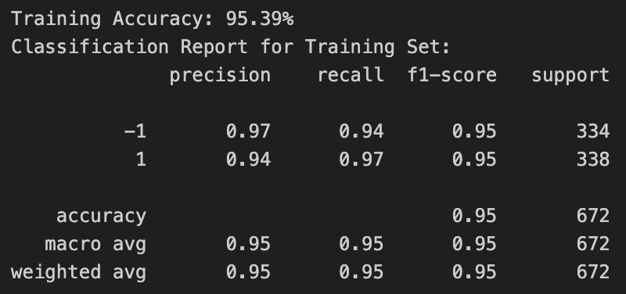

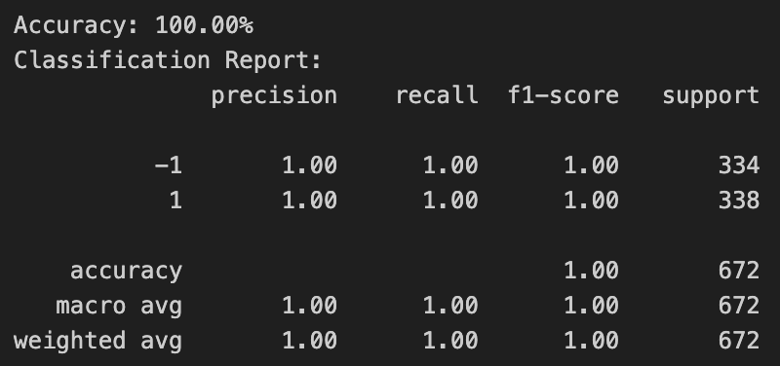

Real Waste- Balanced
SVM
QSVM
TSVM
QTSVM
Notes:
This slide presents the results of different models on the balanced Real Waste dataset, which contains 334 samples of class -1 and 338 samples of class 1.
SVM: Achieved 95.39% accuracy. The recall for class -1 (glass) was 0.94, and for class 1 (metal) it was 0.97, indicating a slight tendency to misclassify some glass samples as metal.
QSVM: Improved accuracy to 99.55%, with near-perfect recall for both classes. Recall for class -1 was 0.99, and for class 1 it was 1.00, demonstrating better performance over SVM.
TSVM: Achieved 100% accuracy, with both precision and recall reaching 1.00 for both classes. This indicates TSVM perfectly separated the two classes in the balanced dataset.
QTSVM: Similarly, QTSVM achieved 100% accuracy, leveraging quantum kernels to deliver perfect performance in all metrics.

Slide 13
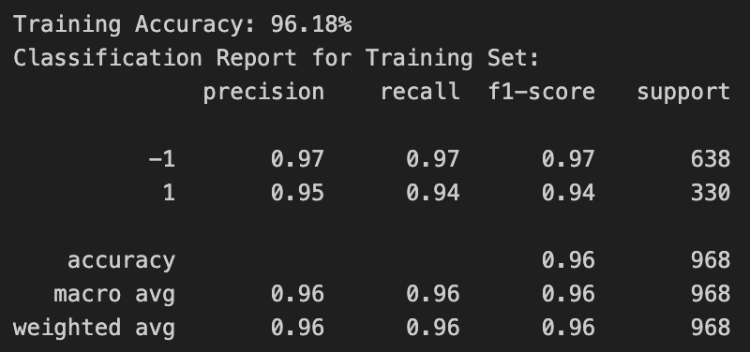
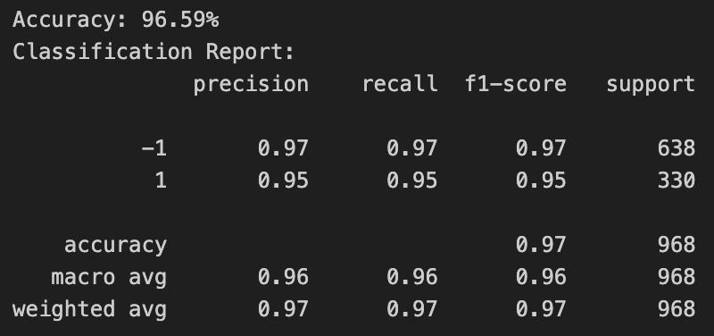


Real Waste- Imbalanced
SVM
USVM
TSVM
UTSVM
Notes:
This slide shows the results of models applied to the imbalanced Real Waste dataset, where class -1 (glass) has 638 samples, and class 1 (metal) has 330 samples:
SVM: Achieved 96.18% accuracy, with a recall of 0.97 for class -1 and 0.94 for class 1. This indicates a slight bias toward the majority class (-1), leading to some misclassifications in the minority class.
USVM: Improved performance slightly, achieving 96.59% accuracy with consistent recall of 0.97 for class -1 and a small improvement to 0.95 for class 1. Universum points helped refine the decision boundary.
TSVM: Achieved 100% accuracy, with perfect recall (1.00) for both classes, highlighting its ability to handle imbalanced datasets effectively by constructing separate hyperplanes.
UTSVM: Delivered 99.69% accuracy, with near-perfect recall of 1.00 for class -1 and 0.99 for class 1. Incorporating Universum points further improved the classification of the minority class.

Slide 14
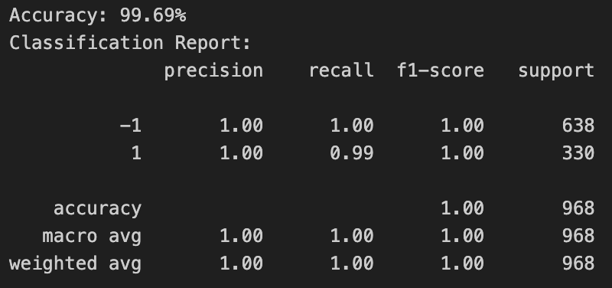
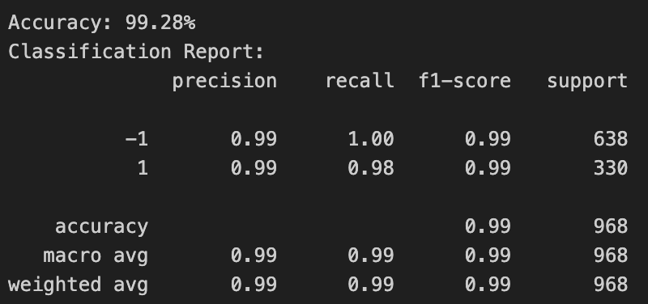

Real Waste- Imbalanced
QSVM
UQSVM
QTSVM
UQTSVM
Notes:
Here, we evaluate quantum-enhanced models:
QSVM: Achieved 99.69% accuracy, with a perfect recall of 1.00 for class -1 and 0.99 for class 1. The quantum kernel improved the minority class performance significantly.
UQSVM: Accuracy slightly reduced to 99.28%, with recall of 0.98 for class 1. Universum points added more flexibility, but the improvement was not as significant as in twin models.
QTSVM: Achieved perfect performance with 100% accuracy and recall of 1.00 for both classes. The quantum kernel and twin hyperplane structure effectively addressed the class imbalance.
UQTSVM: Similarly, UQTSVM delivered 100% accuracy and recall, showcasing the combined power of Universum points and quantum-enhanced decision-making.

Slide 15
Dataset Introduction
Sentiment Labelled Sentences
QSAR androgen receptor
Balanced data
The sentences come from three different websites: imdb.com amazon.com yelp.com
Score is either 1 (for positive) or -1 (for negative)
Class 1 is 1386, class -1 is 1362
Balanced data
Classify 1687 chemicals into 2 classes
class 1 is binder to androgen receptor/positive, class -1 is non-binder to androgen receptor /negative
Downsample the majority class
Imbalanced data
Randomly select 200 for positive, 1300 for negative
Universum point is 1100, obtained from class 1 and class -1
Imbalanced data
Postive has 199, negative has 1488
Universum point is 1289, obtained from postive class and negative class

Slide 16
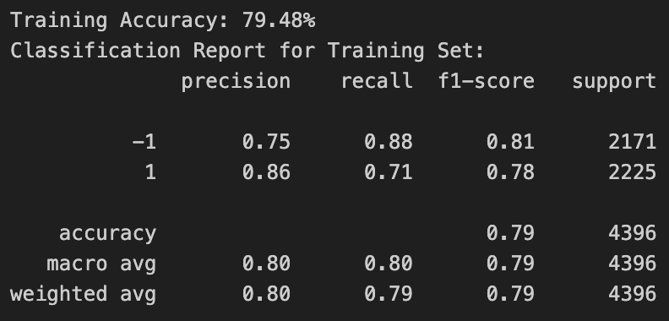

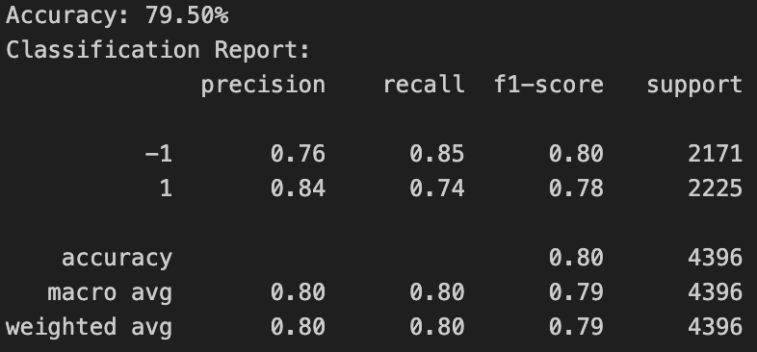
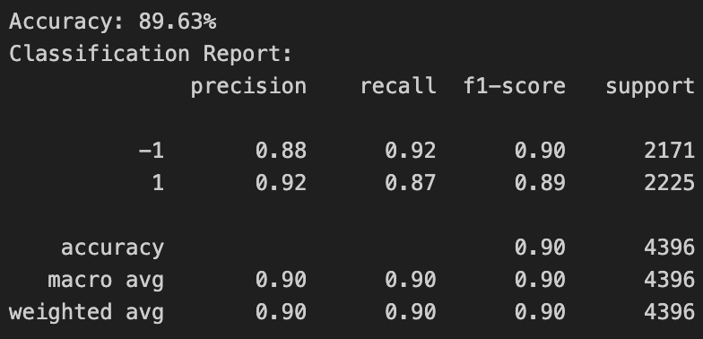
Sentiment Labelled Sentences- Balanced
SVM
QSVM
TSVM
QTSVM
Notes:
This slide shows the results of models applied to the balanced Sentiment Labelled Sentences dataset, where class -1 (negative sentiment) and class 1 (positive sentiment) have approximately equal support. Let’s analyze each model’s performance:
SVM: Achieved 79.48% accuracy, with a recall of 0.88 for class -1 and only 0.71 for class 1. This indicates that the model performs better on negative sentiment sentences than on positive sentiment ones.
TSVM: Slightly improved accuracy to 79.50%, with similar recall values of 0.85 for class -1 and 0.74 for class 1. While TSVM separates the classes better than SVM, it still struggles with class 1.
QSVM: Achieved 84.01% accuracy, significantly improving recall for class 1 to 0.81 and for class -1 to 0.87. This shows the benefit of quantum kernels in capturing the nuances of both sentiment classes.
QTSVM: Delivered the best performance with 89.63% accuracy, achieving recall values of 0.92 for class -1 and 0.87for class 1. QTSVM’s quantum-enhanced and twin hyperplane structure allowed it to handle the dataset effectively, improving overall classification quality. SVM and TSVM provide reasonable baselines but underperform due to challenges with class 1.QSVM and QTSVM effectively handle the balanced dataset, with QTSVM emerging as the best-performing model, achieving 89.63% accuracy and balanced recall across both classes.

Slide 17

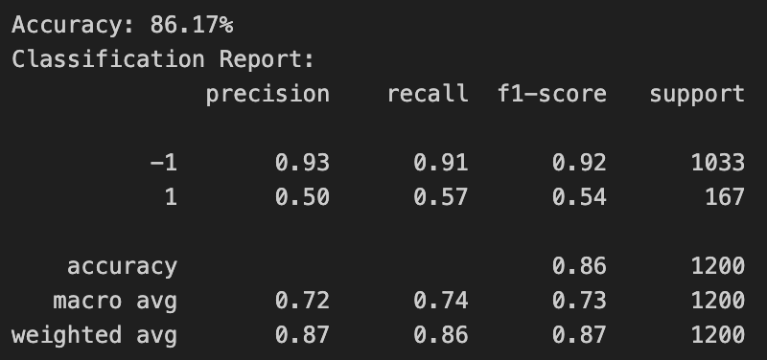
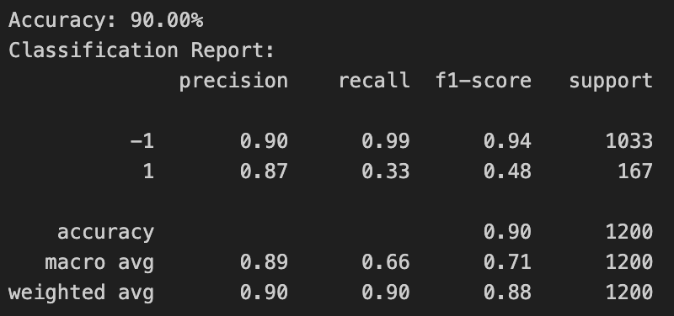
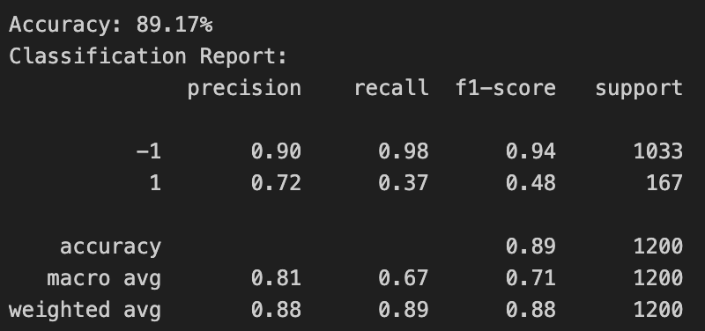
Sentiment Labelled Sentences- Imbalanced
SVM
USVM
TSVM
UTSVM
Notes:
class -1 (negative sentiment) has 1033 samples and class 1 (positive sentiment) has only 167 samples:
SVM: Achieved 88.42% accuracy, with a perfect recall of 1.00 for class -1 but only 0.19 for class 1. This significant drop in recall for class 1 shows SVM's bias toward the majority class.
USVM: Accuracy dropped to 86.17%, but recall for class 1 improved slightly to 0.57. Incorporating Universum points helped mitigate some bias toward class -1.
TSVM: Achieved 90.00% accuracy, with a recall of 0.33 for class 1 and 0.99 for class -1. While it performs better than SVM, it still struggles with the minority class.
UTSVM: Accuracy was 89.17%, with slight improvement in recall for class 1 (0.37). The Universum-based twin model performed better but still showed bias toward the majority class."

Slide 18
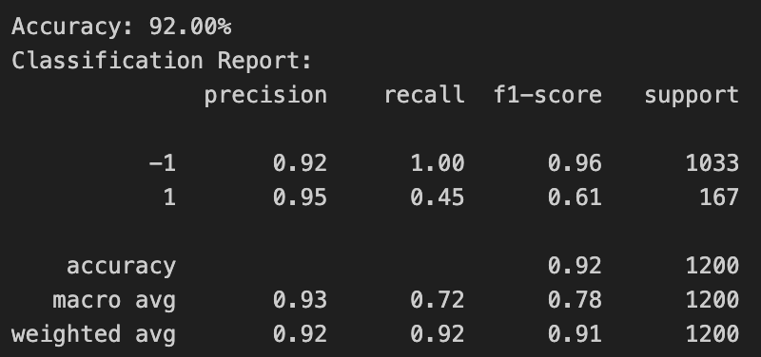

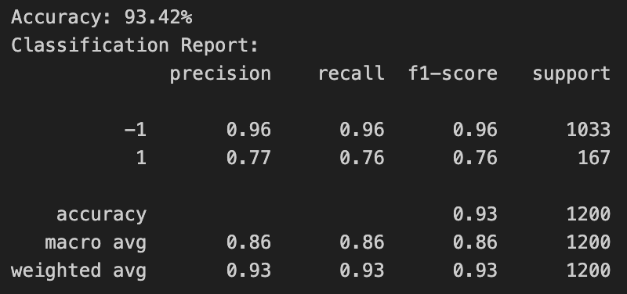
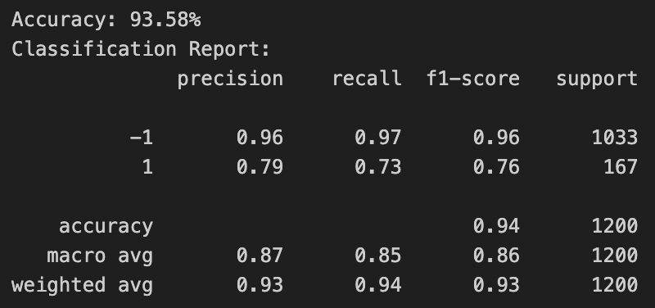
Sentiment Labelled Sentences- Imbalanced
QSVM
UQSVM
QTSVM
UQTSVM
Notes:
QSVM: Achieved 92.00% accuracy, with perfect recall for class -1 (1.00) and improved recall for class 1 (0.45). This indicates quantum kernels can better handle minority classes.
UQSVM: Delivered 91.33% accuracy, with further improvement in class 1 recall to 0.42. The addition of Universum points made the model slightly more robust.
QTSVM: Achieved 93.42% accuracy, with balanced recall for both classes (0.96 for class -1 and 0.76 for class 1). The twin hyperplane structure and quantum kernels effectively addressed the class imbalance.
UQTSVM: The best performer, with 93.58% accuracy and recall values of 0.97 for class -1 and 0.73 for class 1. This model combines the strengths of Universum points and quantum enhancements.

Slide 19
Dataset Introduction
Sentiment Labelled Sentences
QSAR androgen receptor
Balanced data
The sentences come from three different websites: imdb.com, amazon.com, yelp.com
Score is either 1 (for positive) or -1 (for negative)
Class 1 is 1386, class -1 is 1362
Balanced data
Classify 1687 chemicals into 2 classes
class 1 is binder to androgen receptor/positive, class -1 is non-binder to androgen receptor /negative)
Downsample the majority class
Imbalanced data
Randomly select 200 for positive, 1300 for negative
Universum point is 1100, obtained from class 1 and class -1
Imbalanced data
Postive has 199, negative has 1488
Universum point is 1289, obtained from postive class and negative class

Slide 20
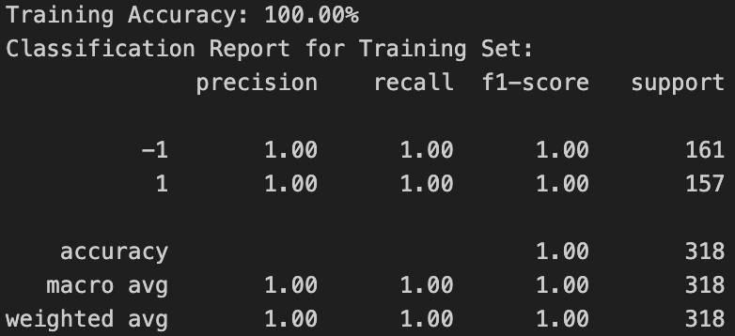
QSAR androgen receptor- Balanced
SVM
QSVM
TSVM
QTSVM
Notes:
This slide presents the results of different models on the balanced QSAR androgen receptor dataset, where both classes have similar support (161 for class -1 and 157 for class 1).
In a balanced dataset with clear decision boundaries, all models—SVM, TSVM, QSVM, and QTSVM—perform equally well, achieving 100% accuracy and perfect precision, recall, and F1-scores.
I guess maybe dataset is too small, and its too simple classficated.

Slide 21
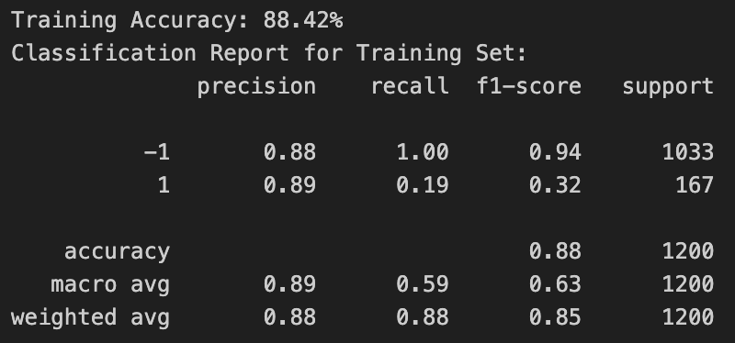
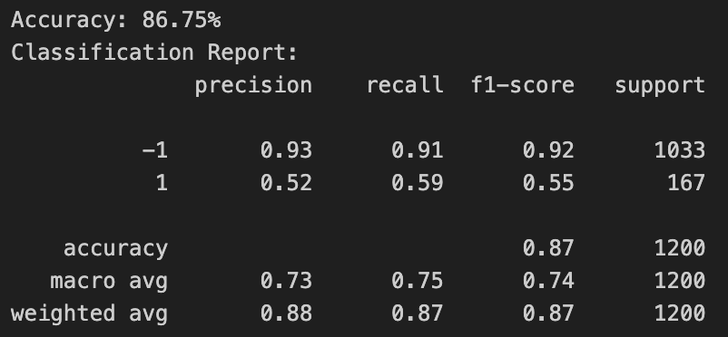
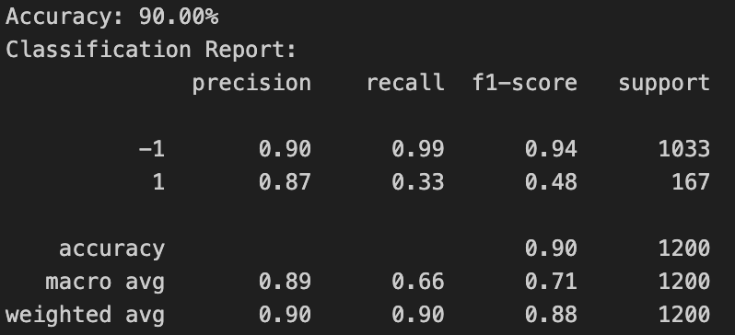
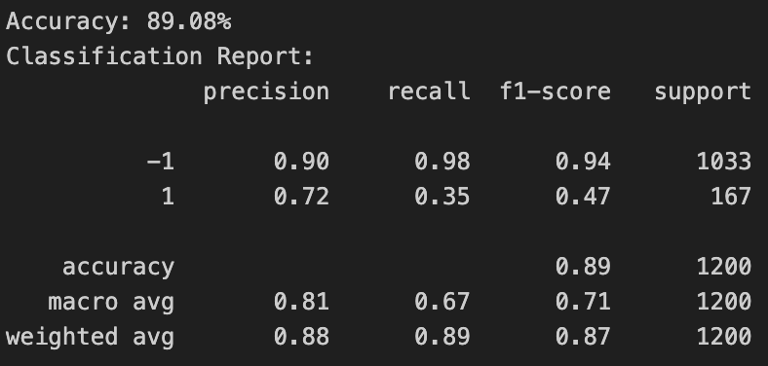
QSAR androgen receptor- Imbalanced
SVM
USVM
TSVM
UTSVM
Notes:
This slide shows the performance of various models on the imbalanced QSAR androgen receptor dataset, where class -1 (negative response) has 1033 samples, and class 1 (positive response) has only 167 samples:
SVM: Achieved 88.42% accuracy, with perfect recall for class -1 (1.00) but only 0.19 for class 1. This shows significant bias toward the majority class, with very poor performance in identifying the minority class.
USVM: Accuracy was slightly lower at 86.75%, but recall for class 1 improved to 0.59, showing the benefit of incorporating Universum points.
TSVM: Achieved 90.00% accuracy, with better recall for class 1 (0.33) compared to SVM. However, the majority class still dominates the decision-making process.
UTSVM: Delivered 89.08% accuracy, with recall for class 1 improving slightly to 0.35, thanks to the twin hyperplane structure and Universum points.

Slide 22

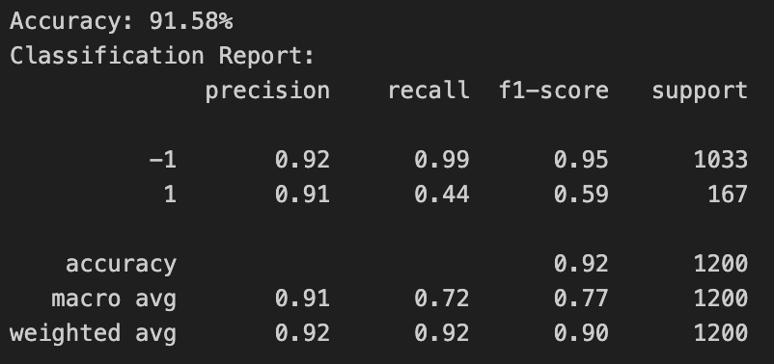
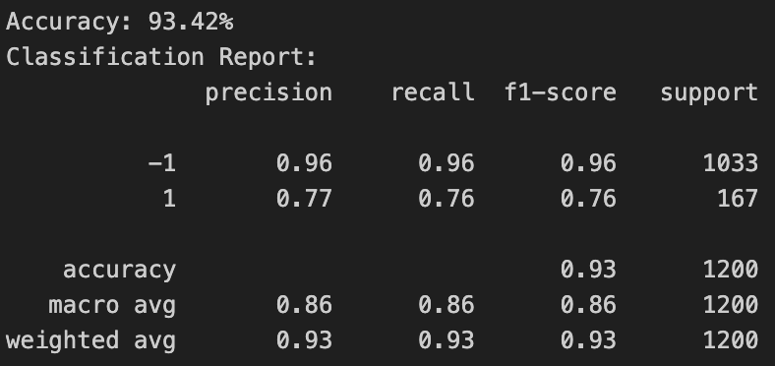
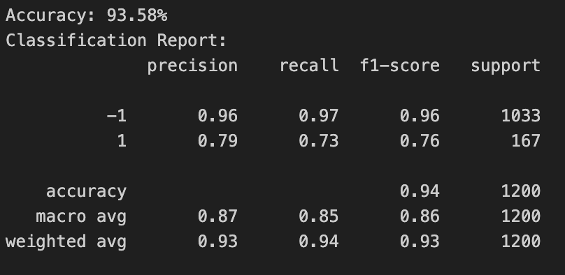
QSAR androgen receptor- Imbalanced
QSVM
UQSVM
QTSVM
UQTSVM
Notes:
QSVM: Achieved 92.00% accuracy, with recall for class 1 improving to 0.45, while maintaining perfect recall for class -1. The quantum kernel improves minority class performance but still struggles to fully address the imbalance.
UQSVM: Accuracy was 91.58%, with recall for class 1 further improving to 0.44. The combination of Universum points and quantum kernels provided better class balance.
QTSVM: Achieved 93.42% accuracy, with balanced recall for both classes (0.96 for class -1 and 0.76 for class 1). The twin hyperplane structure and quantum enhancements handled the imbalance effectively.
UQTSVM: Delivered the best results with 93.58% accuracy and recall values of 0.97 for class -1 and 0.73 for class 1. This shows the combined power of Universum points and quantum kernels in addressing class imbalance.

Slide 23
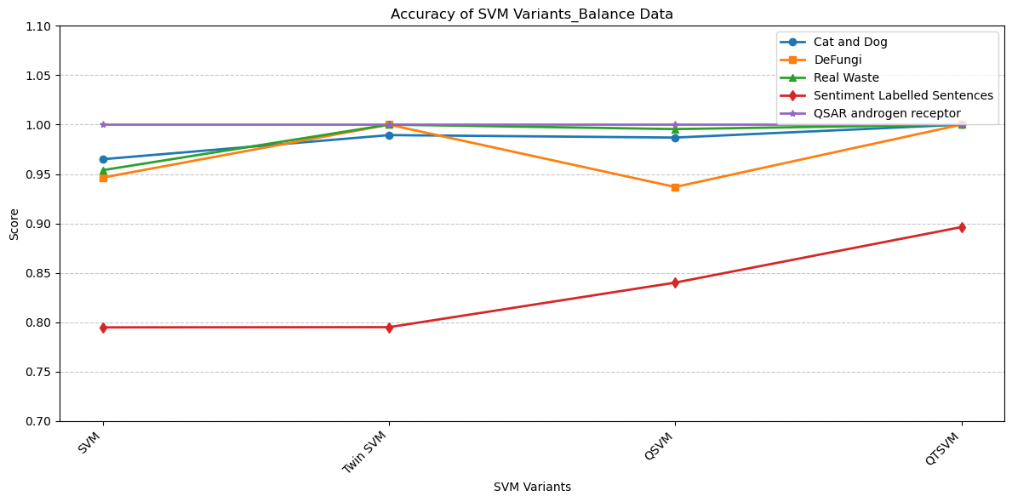
Summary
Notes:
SVM and TSVM have difficulty addressing class imbalance, resulting in poor recall for minority classes.Universum-based models (UTSVM, Universum QTSVM) and quantum-enhanced models (QTSVM, Universum QTSVM) effectively handle imbalanced datasets, with Universum QTSVM achieving the best recall scores overall.

Slide 24
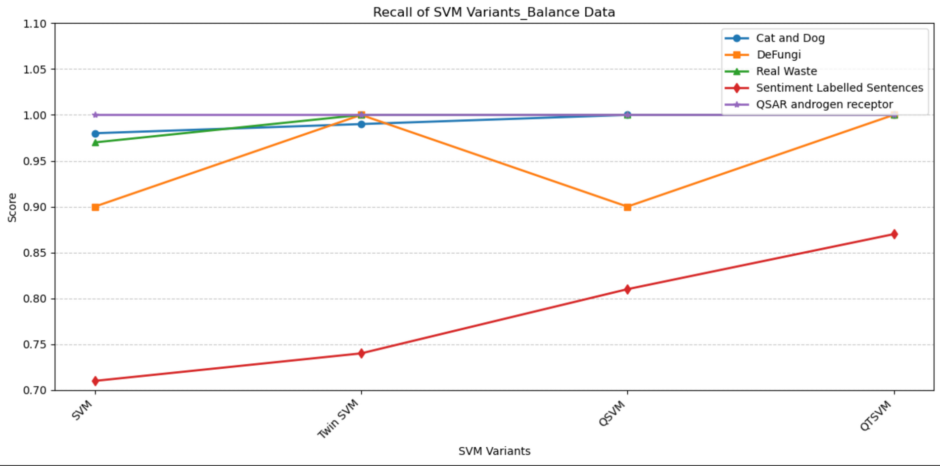
Summary
Notes:
SVM performs adequately in balanced datasets but struggles with complex decision boundaries.TSVM and QTSVM leverage advanced techniques to improve recall, with QTSVM emerging as the most effective model for both straightforward and complex datasets.

Slide 25
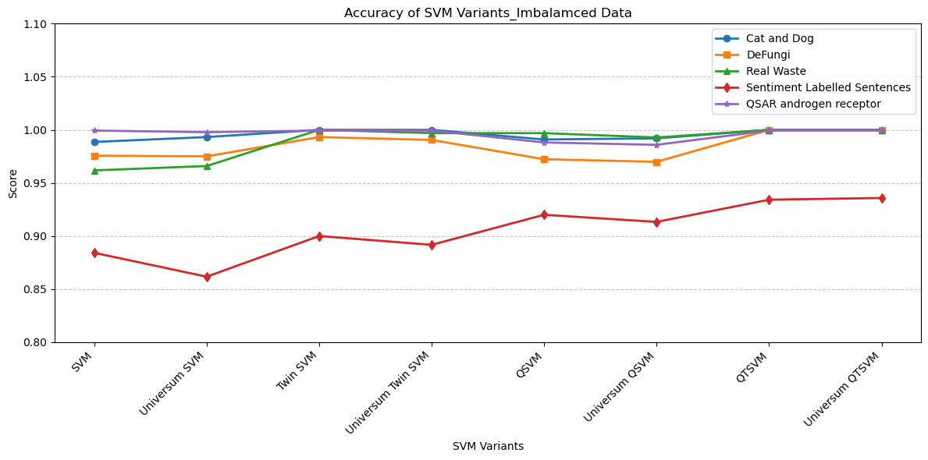
Summary
Notes:
Simple SVM models struggle with imbalanced datasets, particularly those with subtle or overlapping class boundaries (e.g., Sentiment Labelled Sentences).Twin SVM and Universum-based models effectively address class imbalance, improving accuracy by refining the decision boundaries. Quantum-enhanced models, especially QTSVM and Universum QTSVM, outperform all other variants by leveraging advanced kernels and Universum points, achieving the highest accuracy across all datasets.

Slide 26
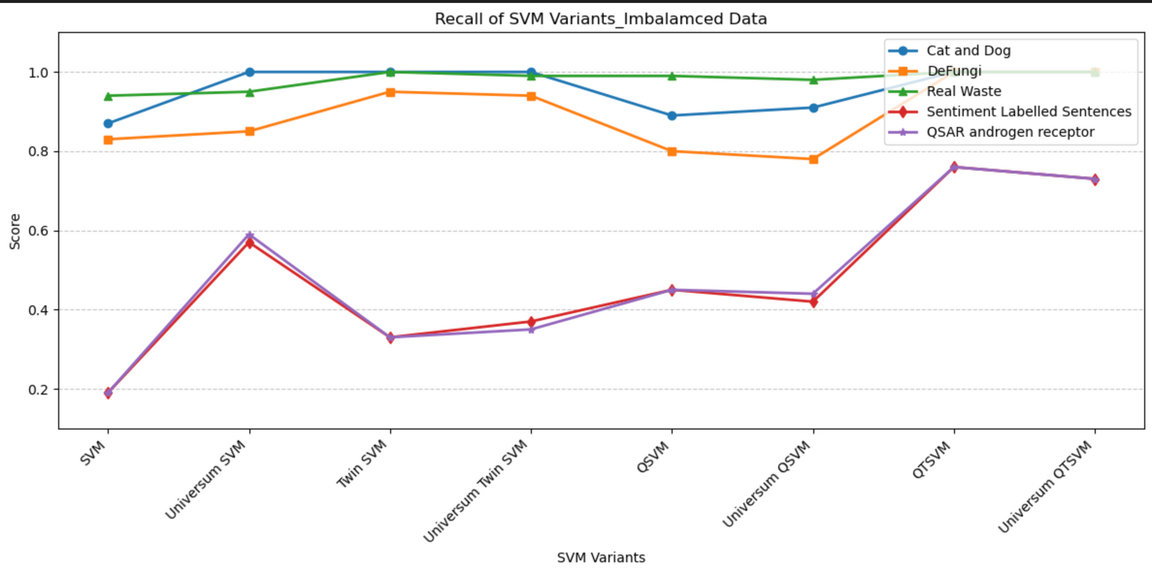
Summary
Notes:
SVM struggles with recall in imbalanced datasets, particularly for minority classes. Universum-based models improve recall moderately, while quantum-enhanced models (especially Universum QTSVM) achieve the best results by effectively addressing class imbalance.

Slide 27
Conclusion
Image data benefits from well-defined features, resulting in strong performance across all SVM variants, even in imbalanced scenarios.
Text data poses unique challenges due to subtle, overlapping patterns and high-dimensional feature spaces, requiring advanced models like QTSVM and Universum QTSVM to achieve better recall, especially for minority classes.
The observed differences highlight the importance of model selection and feature engineering tailored to the type of dataset.
Notes:
Datasets like Cat and Dog, DeFungi, and Real Waste show consistently high recall across all SVM variants. Image data tends to have well-defined features (e.g., color, texture, shape) that are easier for models to differentiate, even in imbalanced scenarios. Advanced models (e.g., Universum QTSVM) still show slight improvements but are less critical due to the inherent separability of image features.
Datasets like Sentiment Labelled Sentence and QSAR Androgen Receptor exhibit significant drops in recall for standard models like SVM and TSVM.
Text data often has overlapping and subtle patterns (e.g., sentiment polarity or molecular descriptors), making it harder to distinguish between classes.
Advanced models such as QTSVM and Universum QTSVM outperform others, as they are better at capturing complex relationships in high-dimensional feature spaces.

Slide 28
References
Will Cukierski. (2013). Dogs vs. Cats. Kaggle. https://kaggle.com/competitions/dogs-vs-cats
Kotzias, D. (2015). Sentiment Labelled Sentences [Dataset]. UCI Machine Learning Repository. https://doi.org/10.24432/C57604.
Hajati, F., Javier Pineda Sopo, C., Hajati, F., & Gheisari, S. (2021). DeFungi [Dataset]. UCI Machine Learning Repository. https://doi.org/10.48550/arXiv.2109.07322.
QSAR androgen receptor [Dataset]. (2019). UCI Machine Learning Repository. https://doi.org/10.24432/C53317.
Single, S., Iranmanesh, S., & Raad, R. (2023). RealWaste [Dataset]. UCI Machine Learning Repository. https://doi.org/10.24432/C5SS4G.

Slide 29
Thank you!

